Slide 1

Microarray Data Analysis
Stuart M. Brown
NYU School of Medicine

Slide 2
What is a Microarray
A simple concept: Dot Blot + Northern
Reverse the hybridization - put the probes on the filter and label the bulk RNA
Make probes for lots of genes - a massively parallel experiment
Make it tiny so you don’t need so much RNA from your experimental cells.
Make quantitative measurements

Slide 3
A Filter Array

Slide 4
DNA Chip Microarrays
Put a large number (~100K) of cDNA sequences or synthetic DNA oligomers onto a glass slide (or other subtrate) in known locations on a grid.
Label an RNA sample and hybridize
Measure amounts of RNA bound to each square in the grid
Make comparisons
  Cancerous vs. normal tissue
  Treated vs. untreated
  Time course
Many applications in both basic and clinical research

Slide 5
cDNA Microarray Technologies
Spot cloned cDNAs onto a glass microscope slide
  usually PCR amplified segments of plasmids
Label 2 RNA samples with 2 different colors of flourescent dye - control vs. experimental
Mix two labeled RNAs and hybridize to the chip
Make two scans - one for each color
Combine the images to calculate ratios of amounts of each RNA that bind to each spot

Slide 6
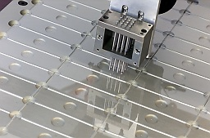
Spot your own Chip
(plans available for free from Pat Brown’s website)
Robot spotter
Ordinary glass
microscope slide

Slide 8
Combine scans for Red & Green
False color image is made from digitized fluorescence data,
not by superimposing scanned images

Slide 9
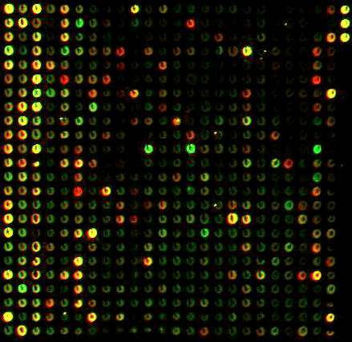
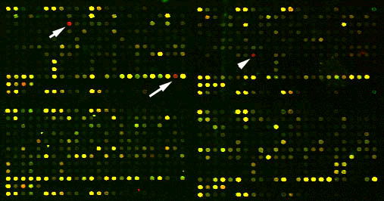
cDNA Spotted Microarrays

Slide 11
Affymetrix “Gene chip” system
Uses 25 base oligos synthesized in place on a chip (20 pairs of oligos for each gene)
RNA labeled and scanned in a single “color”
  one sample per chip
Can have as many as 20,000 genes on a chip
Arrays get smaller every year (more genes)
Chips are expensive
Proprietary system: “black box” software, can only use their chips

Slide 12
Affymetrix Gene Chip

Slide 13
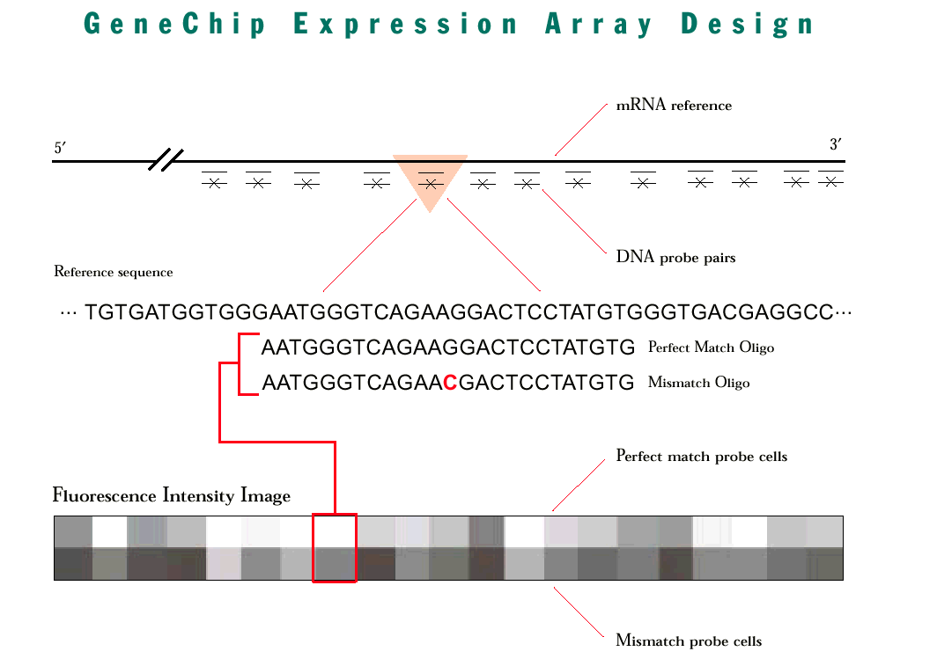

Slide 14
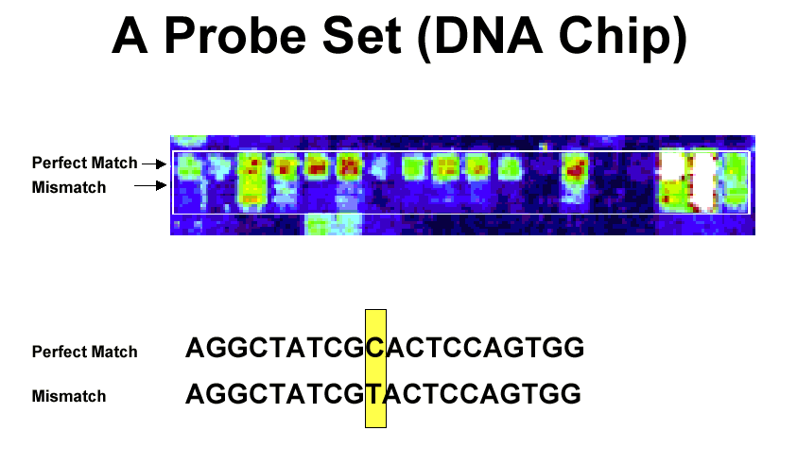

Slide 15
Affymetrix Technology

Slide 16
“Long Oligos”
Like cDNAs, but instead of using a cloned gene, design a 40-70 base probe to represent each gene
Relies on genome sequence database and bioinformatics
Reduces cross hybridization
Cheaper and possibly more sensitive than Affy. system

Slide 17
Data Acquisition
Scan the arrays
Quantitate each spot
Subtract background
Normalize
Export a table of fluorescent intensities for each gene in the array

Slide 18
Automate!!
All of this can be done automatically by software.
Much more consistent
Mistakes will be made (especially in the spot quantitation) but you can’t manually check hundreds of thousands of spots

Slide 19
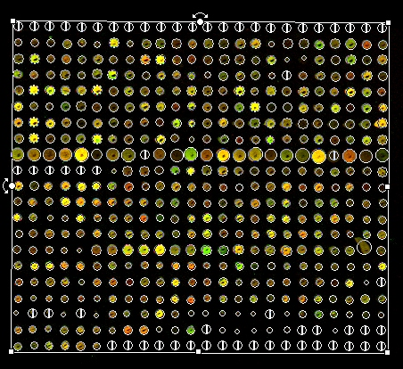

Slide 20
Affymetrix Software
Affymetrix System is totally automated
Computes a single value for each gene from 40 probes - (using surprisingly kludgy math)
Highly reproducible
(re-scan of same chip or hyb. of duplicate chips with same labeled sample gives very similar results)
Incorporates false results due to image artefacts
  dust, bubbles
  pixel spillover from bright spot to neighboring dark spots

Slide 21
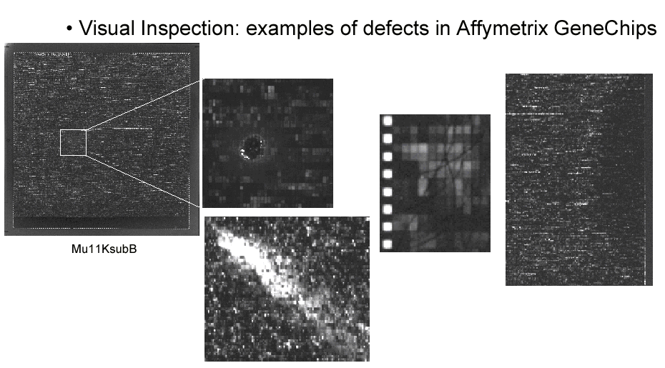

Slide 22
Basic Data Analysis
Fold change (relative increase or decrease in intensity for each gene)
Set cutoff filter for low values
(background +noise)
Cluster genes by similar changes - only really meaningful across multiple treatments or time points
Cluster samples by similar gene expression profiles

Slide 23
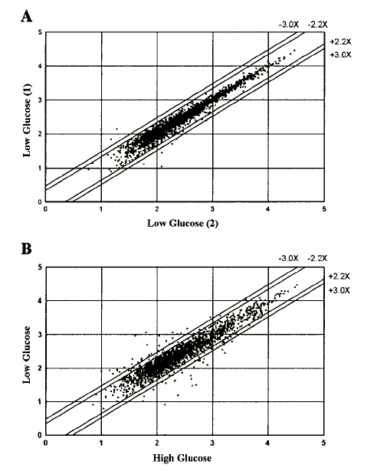
Scatter plot of all genes in a simple comparison of two control (A) and two treatments (B: high vs. low glucose) showing changes in expression greater than 2.2 and 3 fold.

Slide 24
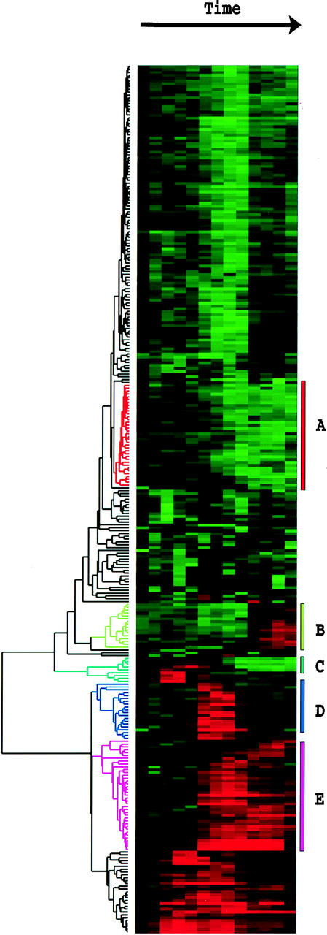
Cluster by color difference

Slide 25
Microarry Data Variablity
Microarray data are inherently highly variable - you are measuring mRNA levels
Any kind of measurement of thousands of values across 2 samples will find some large differences due to chance (normal distribution)
Must have replication and statistics to show that differences are real

Slide 26
Sources of Variability
Image analysis (identifying and quantitating each spot on the array)
Scanning (laser and detector, chemistry of the flourescent label))
Hybridization (temperature, time, mixing, etc.)
Probe labeling
RNA extraction
Biological variability

Slide 27
Normalization
Can control for many of the experimental sources of variability (systematic, not random or gene specific)
Bring each image to the same average brightness
Can use simple math or fancy -
  divide by the mean (whole chip or by sectors)
  LOESS (locally weighted regression)
No sure biological standards

Slide 28
Real Differences?
Spots with low intensity will show much greater percent variability than bright spots
  Background and machine variability represent a much larger fraction of the total measurement
Fold change is often much greater for low intensity samples (absolute amount of RNA is small)
If you normalize by dividing all samples by the mean, then genes that express at this level will have their variation suppressed

Slide 29
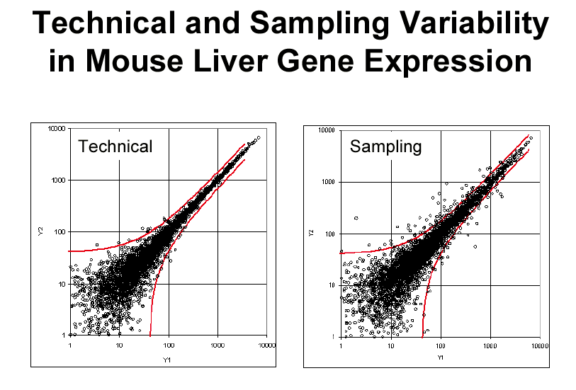
Thomas Hudson, Montreal Genome Center

Slide 30
Multiple Comparisons
In a microarray experiment, each gene (each probe or probe set) is really a separate experiment
You can’t look at a set of microarray data and ask if the overall average gene expression is different between two treatments
Yet if you treat each gene as an independent comparison, you will always find some with significant differences

Slide 31
Gene-Specific Variability
Different probes will hybridize to mRNAs with different efficiency
  microarrays can only measure relative change of expression, not absolute levels
Cross-hybridization
  Gene families
  Chance similarity of short oligo sequence
Affy mis-match >> perfect match for many probes
Diff. Affy probes for the same gene show huge differences in hyb intensity
Alternative splicing!!

Slide 32
Statistics
When you have variability in measurements, you need replication and statistics to find real differences
It’s not just the genes with 2 fold increase, but those with a significant p-value across replicates
Non-parametric (i.e. rank) or paired value statistics may be more appropriate

Slide 33
Experimental Design
Real replicates!
  (same treatment, same biological source, different RNA prep, labeling, hybridization, and scanning)
Dye reversal for two color hybs.
Block design (don’t do exp. on one day and control on another)
Work with a Statistician!!

Slide 34
Higher Level
Microarray data analysis
Clustering and pattern detection
Data mining and visualization
Controls and normalization of results
Statistical validatation
Linkage between gene expression data and gene sequence/function/metabolic pathways databases
Discovery of common sequences in co-regulated genes
Meta-studies using data from multiple experiments

Slide 35
Types of Clustering
Herarchical
  Link similar genes, build up to a tree of all
Self Organizing Maps (SOM)
  Split all genes into similar sub-groups
  Finds its own groups (machine learning)
Principle Component
  every gene is a dimension (vector), find a single dimension that best represents the differences in the data

Slide 36
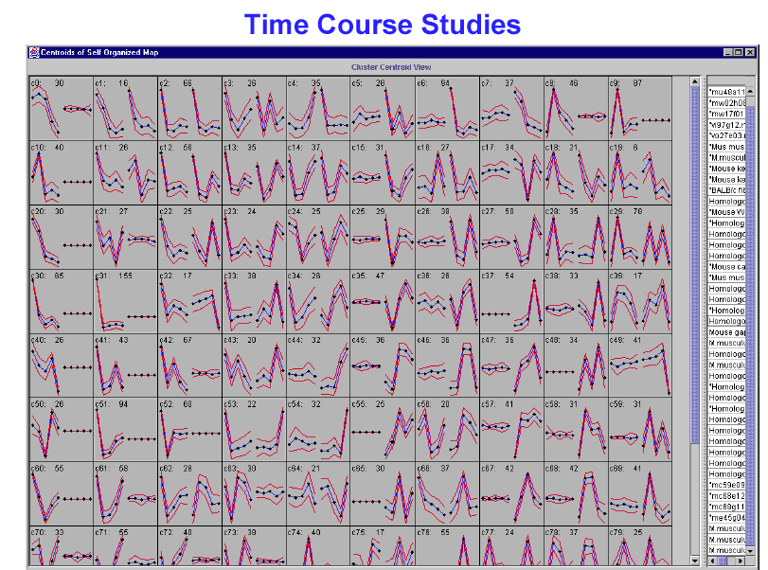

Slide 37
Microarray Databases
Large experiments may have hundreds of individual array hybridizations
Core lab at an institution or multiple investigators using one machine - data archive and validate across experiments
Data-mining - look for similar patterns of gene expression across different experiments

Slide 38
Public Databases
Gene Expression data is an essential aspect of annotating the genome
Publication and data exchange for microarray experiments
Data mining/Meta-studies
Common data format - XML
MIAME (Minimal Information About a Microarray Experiment)

Slide 39
GEO at the NCB_x0008_I

Slide 40
Array Express at EMBL

